Slide 1
Almost Infinite Site Recursion

Slide 2
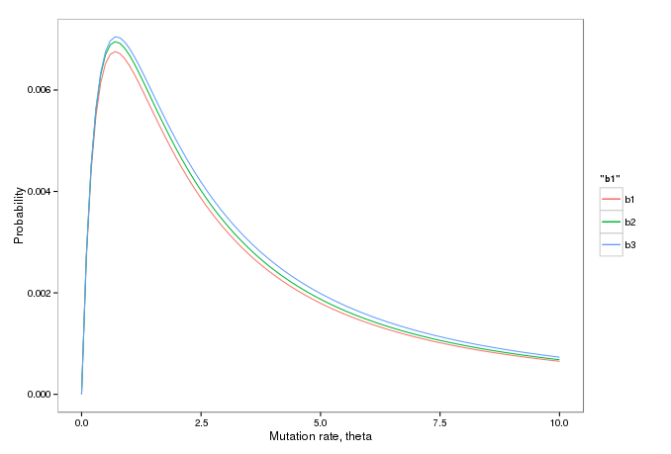
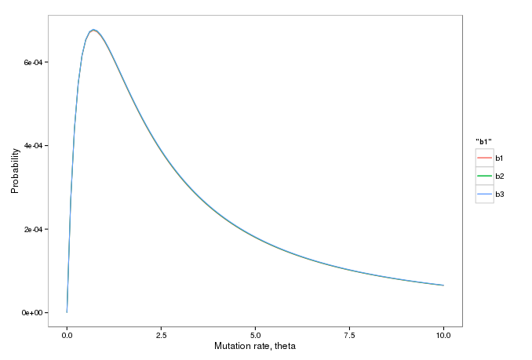

Solutions of the Almost Infinite Sites Model
Length of the sequence = 10
Length of the sequence = 100

Slide 3
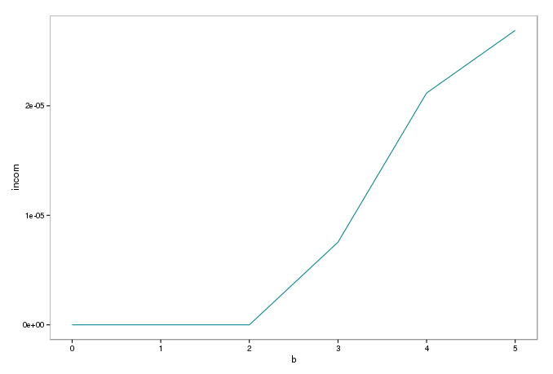
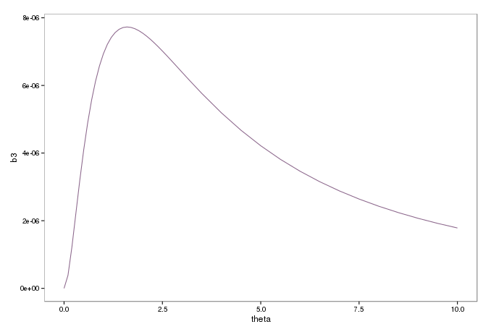
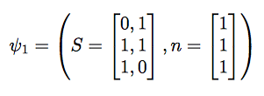
Incompatible configurations in the Almost Infinite Sites Model
Probabilities with different number of mutations
Length of the sequence = 10, mutations=3

Slide 4
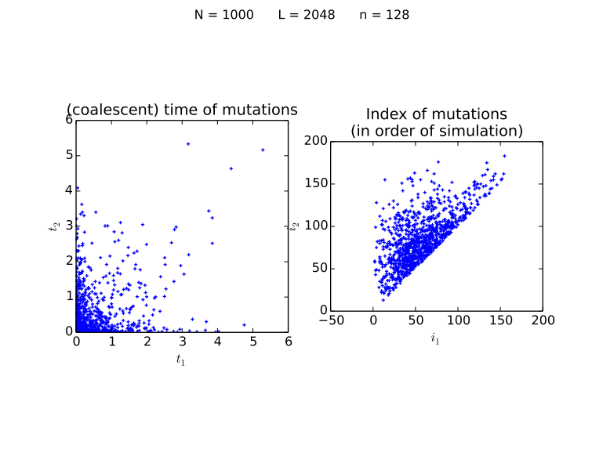
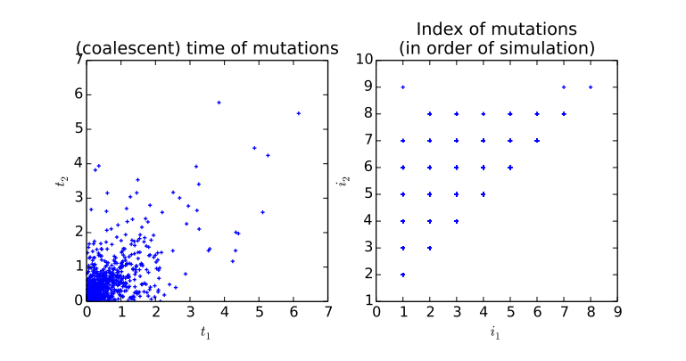
Stopping after 2 degenerate mutations
Simulate a coalescent tree (no mutations)
Vary the following:
L – Number of positions
N – Number of Sequences/leaves
Keep adding mutations until 2nd violation of infinite-sites assumption
Mutations added uniformly along branches of coalescent tree
On the right: How many mutations do we need to add; how far are they apart in index and (coalescent) time.
Classify what type of inconsistency is introduced (next slide).
L = 2048 n = 128
L = 8 n = 2

Slide 5
